Slide 1
Requirements
Samuel Arseneault, Kelly Markaity, John Luu

Slide 2
Introduction
Purpose
The purpose of this Software Requirements Specification document is to provide a detailed description of the functionalities of the Rocket Math system. This document will cover each of the system’s intended features, as well as present the user interface of each component of the system. The document will also cover hardware, software, and various other technical dependencies.

Slide 3
Introduction Continued...
Scope
This iOS application is based around Common Core Standards for mathematics aimed at a First grade level demographic. The goal is to aid these student in attaining skills to solve single digit addition problems. This education will be delivered via an iPad application that is accessible from the Apple store. Teachers and faculty will be able to access the administrative portion of this application to create separate classes as well as creating the students for each class. The teachers will be able to facilitate this process through a web portal. Within the web portal the teachers will be able to access information such as time spent on levels, overall progress and which levels they have been stuck on. All of this data is stored in our database and is retrievable so long as they have internet connectivity.

Slide 4


Name Change
Notes:
We have finally got rid of the rocket math name, and had our client agree on a car theme. Although, as of right now it’s called Car Math or Math Racer, but we will eventually want to change the name.

Slide 5
Overview
Overview
In the next following slides we will be discussing the general description of how the system works along with a high level perspective. User interactions, functional and nonfunctional requirements as well as how the data will flow through our system.
Notes:
Next Sam will be going over the User interfaces, the web portal and iOS app while Kelly will be covering the functional and nonfucntional requirements.k

Slide 6
Product Functions

Slide 7
User Characteristics
Constraints, Assumptions Depen

Slide 8
User Interfaces
Types of users:
Students
Teachers
Notes:
Since our system will have only two types of users, students and teachers, they will be interacting with the web portal and the iOS application. The web portal will contain a login page, a registration page, and a default teacher view page where a teacher can edit information about her class and change settings for the iOS application.
For the iOS application there will be a login screen, a registration screen, then a main menu screen which the students will be able to select levels and begin testing.

Slide 9
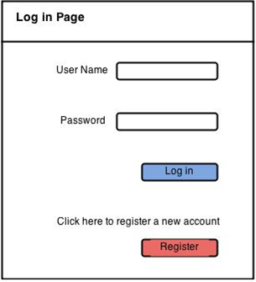
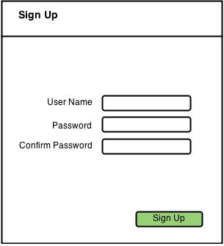
Web Portal
Notes:
Here are some wire diagrams from our requirements document. For the next few slides I’m going to walk through them as if the teacher was a first time user (just so we can cover a larger scope of the UI). In the example presented, the teacher would have to follow through the sign up step.
The web portal will initially start with a login page which will allow the teacher to input their credentials. If they are not registered with the system, they will have the ability to select a register button and enter a signup page.

Slide 10
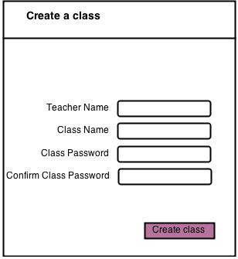
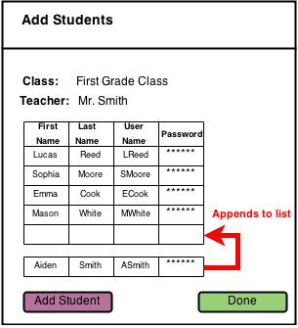
Creating a Class
Notes:
After signing in, a pre-existing user would normally enter a teacher view, but since we are walking through a new user scenario the teacher will be presented with these menus. First the teacher will be able to create a class, and they will be asked to enter information like the teacher's name, class name, and the password.
After a teacher has created a class she will be asked to add students to the class. As you can see with the figure on the right there will be a small table with basic student information. The teacher would simply enter in the requested information, and begin adding students. Once they are finished they would just selected “Done”

Slide 11
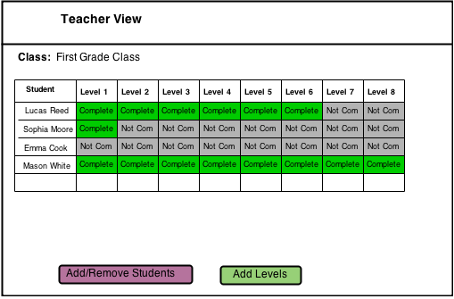
Teacher View
Notes:
This is the view I was referring to earlier, which the teacher would automatically enter after signing in; of course after they’re registered, and have set up a class.
Inside of the teacher view, a teacher will be able add and remove students and add levels. Most importantly they will be able to observe a high level overview of her class. They will be able to see a table of their students, along with the levels they have and have not completed.
They will also have the ability to select the completed levels which will bring them to the level progress view.

Slide 12
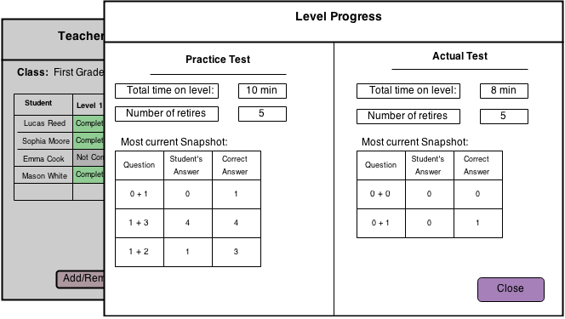
Level Progress
Notes:
Inside of the level progress view this is where the teacher will have the ability to assess the MOST CURRENT practice and actual tests. They can observe information like the total time on the level along with the number of retires. They can also view the most current snapshot of the the students level end. This snapshot shows all the questions they took and their answers.

Slide 13
Notes:
Returning back to the teacher view. The teacher can select the add levels button to open the add new level view.

Slide 14
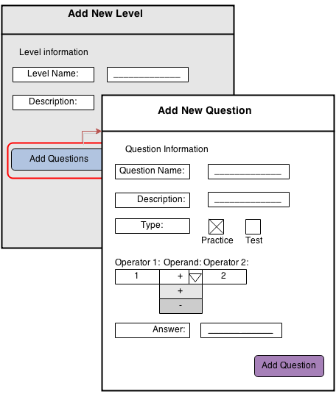
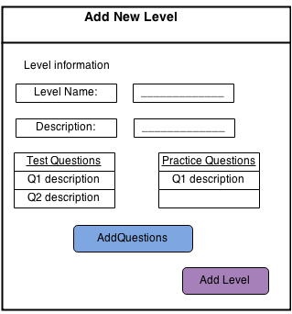
Adding Levels & Questions
Notes:
Inside of the add new level a teacher can enter information about the level name, the description, and will have an option to add questions.
After selecting the add questions button, a teacher will now be presented with the add question view. Here, they will be able to enter information about a single question such as the Name, Description, it’s type (Practice or a test), and of course the question itself.

Slide 15
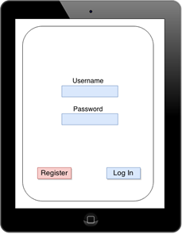
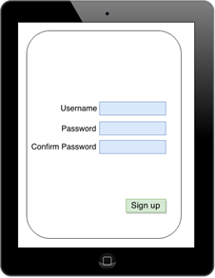
iOS Application
Notes:
Now for the iOS application, will have the ability to login when they enter their credentials. Again if they are not pre-existing users, they will have the ability to follow a signup page by selecting the register button.

Slide 16
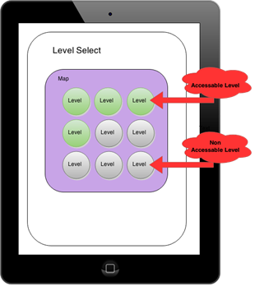
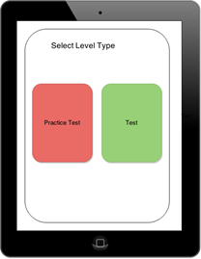
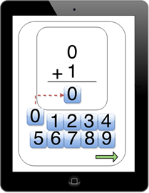
Level Select
Notes:
After a student signs in they will be presented with a level select view. Here they may select the desired level, which they have unlocked. After selecting a level, they will be prompted with the level type view. In this view, they will have a choice between a practice test, and a real test.
Once they are in the actual test, they will be prompted with a series of questions. These questions and timer will be set by the teacher in the web portal.
Next Kelly will be presenting about the functional and nonfunctional requirements.

Slide 17
Functional Requirements
User Class 1 - Student
User Class 2 - Teacher
Notes:
For the functional requirements section of our document, we split it into two sections. The first is user class 1, which details the fundamental features for the iOS application that the students will be using. User class 2 describes the fundamental features the teacher will be using for the web portal section of our project.

Slide 18
User Class 1 - Student
iOS Application
Username and Password
Main Menu
Level Selection
Practice and Test Section
Notes:
These requirements involve the iOS application for our project and the features the students will be using.
Some of these functional requirements include being able to download the iOS application to an iPad through Apple's app store.
Being able to register for the application or log in to existing account where information is saved.
Once logged in a main menu will appear and the students will be able to see what levels they have completed and the current level they are on.
The students will have the option of working on a previous level or try to complete most current level.
Any level has choice between a practice section or a test section.

Slide 19
User Class 2 - Teacher
Account Information
Create Class/Add Students
Class Progress
Detailed Student Report
Add Level
Create Question
Notes:
These requirements involve the web portal section for our project and the features the teacher will have.
The teacher will access to a web portal that will give her administrative features to manage class.
The teacher will have the option to create a new class to add into the systems database.
The teacher will be able to add students to existing class or a new class.
The web portal will have a menu that will show progress of the class. For example, it will display who has completed what level and who has yet to finish certain levels.
The teacher can click on an individual student within the web portal and a new view will display that students data. (How long the student has been on a level, number of retries, most current snapshot or questions they have answered).
The teacher will have the ability through the web portal to add new levels to the iOS application.
There is a feature that will allow the teacher to add new questions to an existing level or a new level.

Slide 20
Non-Functional
iOS Application
Web Portal
Internet Connection
Login Security
Encryption
Design Constraints
Notes:
Some of the iOS application non functional requirements include.
A maximum of 15 seconds for the app to boot.
A 100% reliability that the app returns the correct answer.
Internet connection is crucial for this project to work. This will ensure that the application and web portal can communicate with the database.
For the application and web portal there will be strict log in requirements to ensure account safety (Ex, after 5 failed login attempts you will not be able to log in for a certain period).
Both the web portal and application will use encryption when sending information between the database. Account information will also be encrypted.
Some of the design constraints for our system are that the application can be no larger than 4000 mb because this is the maximum size apple will allow to be on there store. We plan on our app only being 50 mb. The iPads the students will be using must have iOS 7 or any thing higher to ensure the application will work.
For the web portal the teacher must be using google chrome but we are planning on having it work for chrome, safari, explorer and firefox.

Slide 21
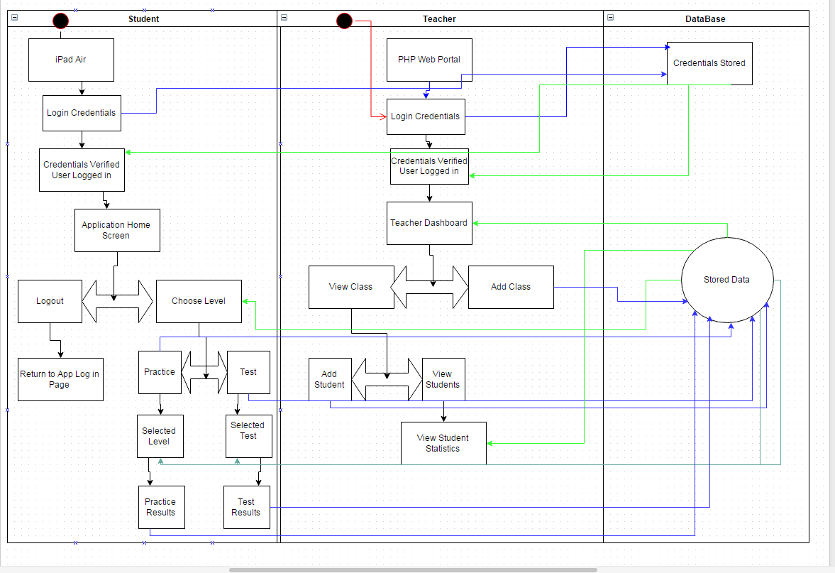
DFD

Slide 22
Prioritization
High level requirements -
High priority
Additional functionality -
Medium priority
Performance requirements -
Low priority
Notes:
While prioritizing the requirements the team decided to pick out the top 20 requirements which were the most important for the system to exist. For example, requirements that state the web portal, iOS app, and the database in a high level perspective. Medium priority are requirements that add additional functionality, for example a teaching being able to add students and levels. Finally the low priority requirements are the performance requirements and the graphics.

Slide 23
Release Plan
Release 1
Release 2
Release 3
Notes:
The release plan is broken up into three releases in the first release we have the requirements defining the basic web portal login, the iOS app login, and the database to handle these operations.
The second release plan increases and its all about adding functionality. In this release the web portal should be able to add classes, students, levels, and questions. The iOS application should have the playable levels, and the security requirements will be implemented. We also plan to have the graphics started in this release.
By the final release we will have the database completed, the Web portal completed, the iOS app completed, and the performance requirements should be implemented. This release will also cover the testing and debugging phase.

